Slide 1

N
CFS Service Overview
Services
NEAN
CENTRAM
BELIZE
SURINAME
GUYANA
TGS
MITMAR
MITVEN
N
W
E
S

Slide 2
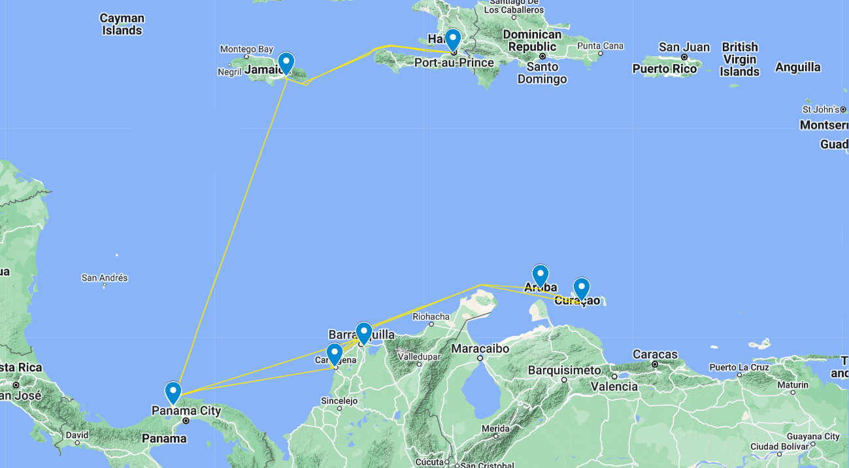
NEAN Service
CAU
Rotation
CCT | Colon (PA)
MIT | Manzanillo (PA)
BAQ | Baranquilla
CTG | Cartagena
WIL | Willemstat
ORJ | Oranjestad
CTG | Cartagena
CCT | Colon (PA)
MIT | Manzanillo (PA)
KIN | Kingston
PAP | Port-au-Prince
KIN | Kingston
CCT | Colon (PA)
PAP
KIN
HAI
STC
ORJ
WIL
BAQ
CTG
CCT
MIT
N
W
E
S

Slide 3
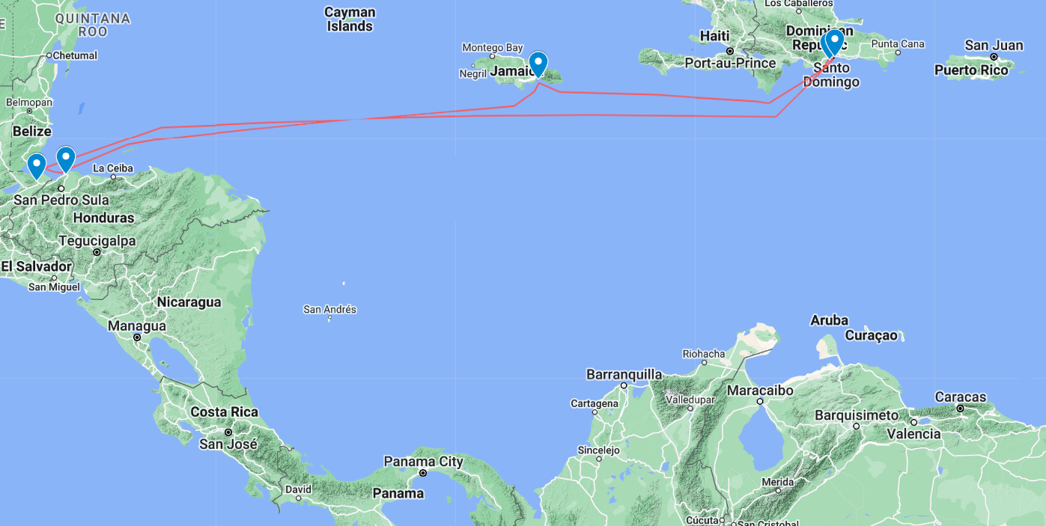
CENTRAM Service
CAU
Rotation
CAU | Caucedo
HAI | Haina
KIN | Kingston
PCR | Puerto Cortes
STC | Santo Tomas de Castilla
CAU | Caucedo
KIN
HAI
STC
PCR
N
W
E
S

Slide 4
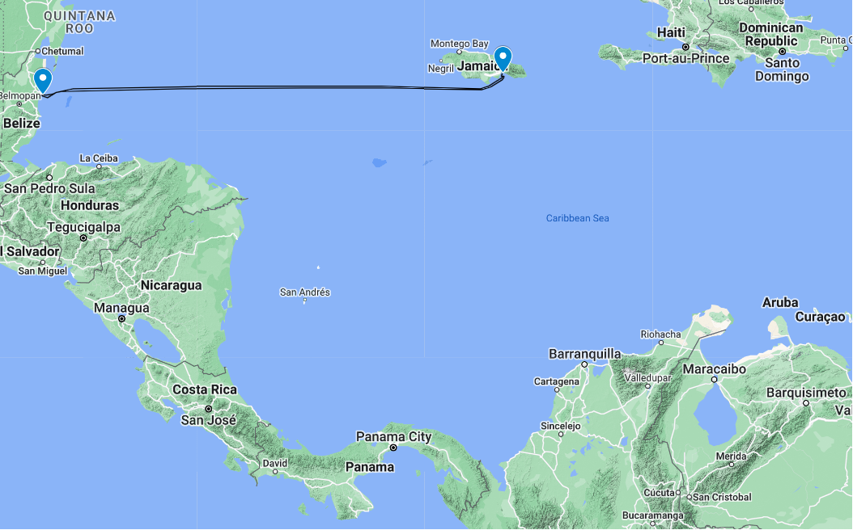
N
BELIZE Service
Rotation
KIN | Kingston
BZE | Belize
KIN | Kingston
CAU
KIN
KIN
BZE
BGI
POS
N
W
E
S

Slide 5
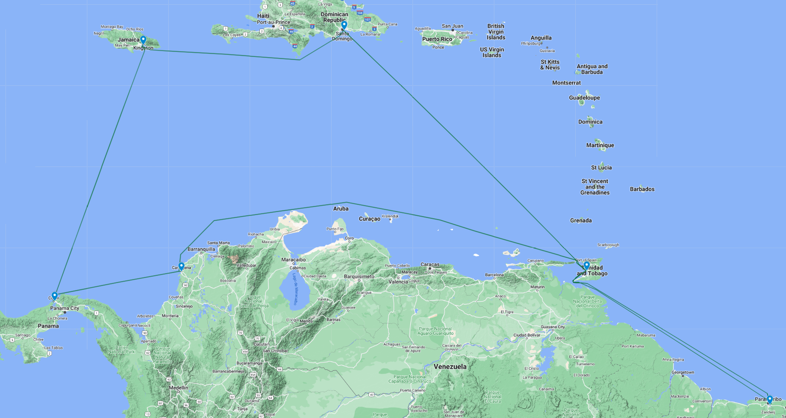
SURINAME Service
Rotation
CTG | Cartagena
MIT | Manzanillo (PA)
KIN | Kingston
CAU | Caucedo
PTS | Point Lisas
PBM | Paramaribo
PTS | Point Lisas
CTG | Cartagena
CAU
KIN
PTS
CTG
MIT
N
W
E
PBM
S

Slide 6
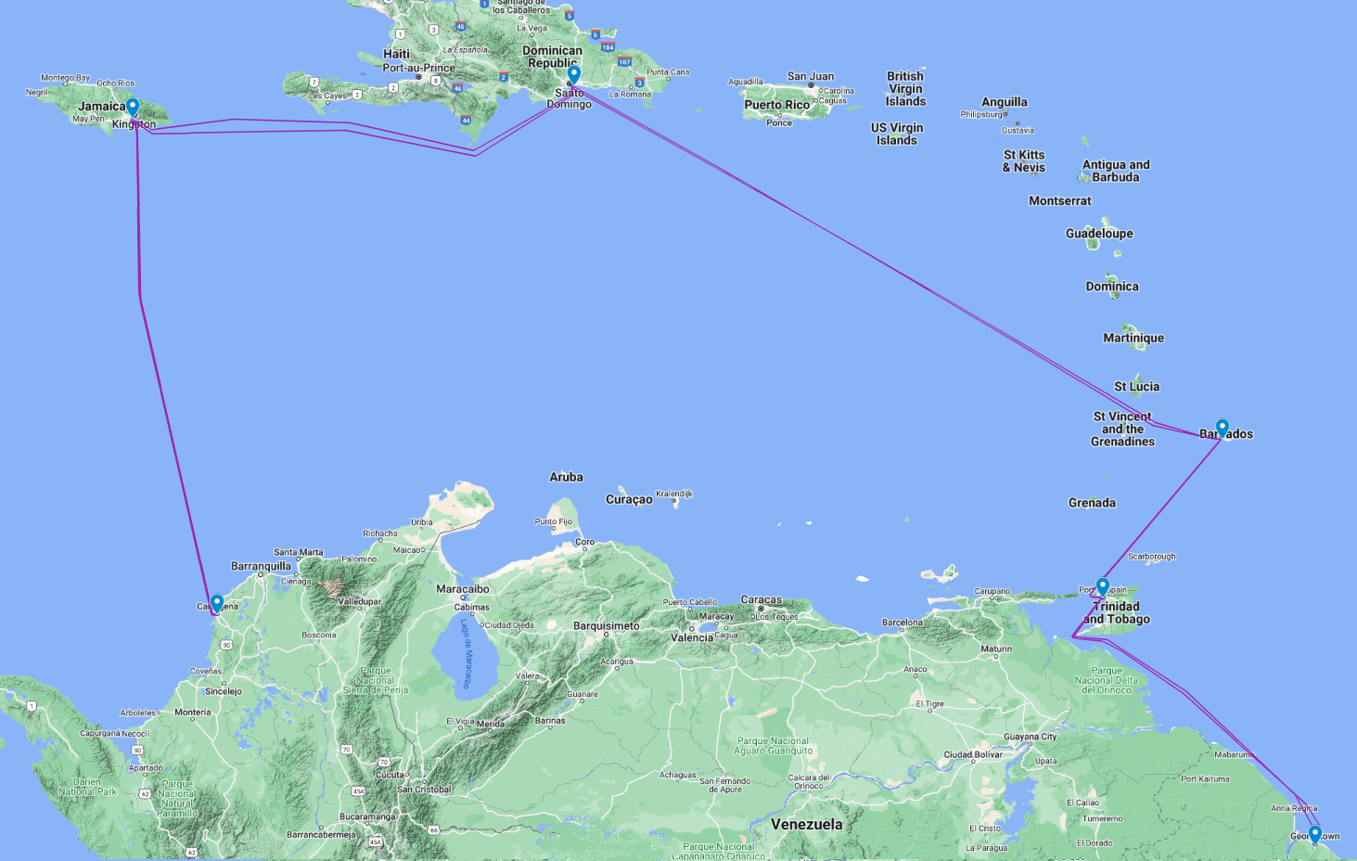
GUYANA Service
Rotation
CTG | Cartagena
KIN | Kingston
CAU | Caucedo
BGI | Bridgetown
POS | Port of Spain
GEO | Georgetown
POS | Port of Spain
BGI | Bridgetown
CTG | Cartagena
CAU
KIN
BGI
CTG
POS
N
W
E
GEO
S

Slide 7
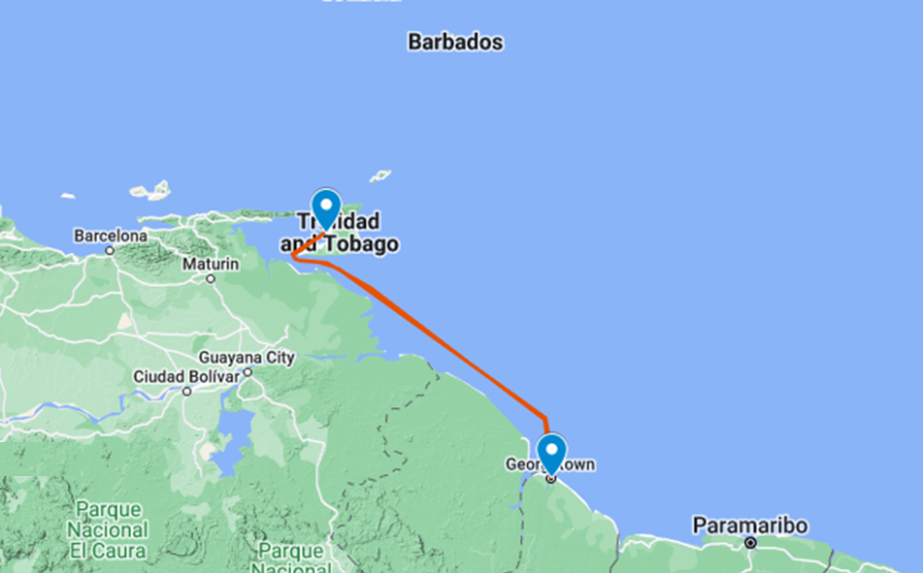
TRINIDAD GUYANA Service (TGS)
Rotation
PTS | Pint Lisas
GEO | Georgetown
PTS | Point Lisas
PTS
GEO
N
W
E
S

Slide 8
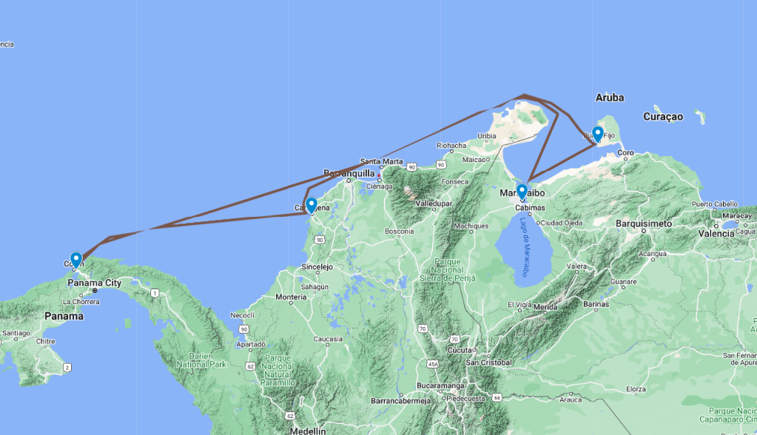
N
MITMAR Service
Rotation | Rotation
 | CTG | Cartagena
 | MIT | Manzanillo (PA)
 | GUB | Guranao
 | MAR | Maracaibo
 | CTG | Cartagena
KIN
GUB
MAR
CTG
MIT
N
N
W
E
W
E
S
S

Slide 9
N
MITVEN Service
Rotation
LOOP I | MIT | Manzanillo (PA)
 | CTG | Cartagena
 | LAG | La Guaira
 | PBL | Puerto Cabello
 | MIT | Manzanillo (PA)
LOOP II | CTG | Cartagena
 | LAG | La Guaira
 | GUT | Guanta
 | PBL | Puerto Cabello
 | MIT | Manzanillo (PA)
KIN
PBL
LAG
CTG
MIT
GUB
CTG
N
N
W
E
W
E
S
S

